Slide 1
Do Incentives Work? Assessing the Impact of Economic Incentives on Industry Growth
Christian Conroy
PPOL 528-11
Fall 2018

Slide 2
Outline
Motivation
Question
Background & Literature Review
Conceptual Framework
Empirical Framework
Data
Description
Sample: selection criteria, size
Summary Stats
Preliminary Results

Slide 3
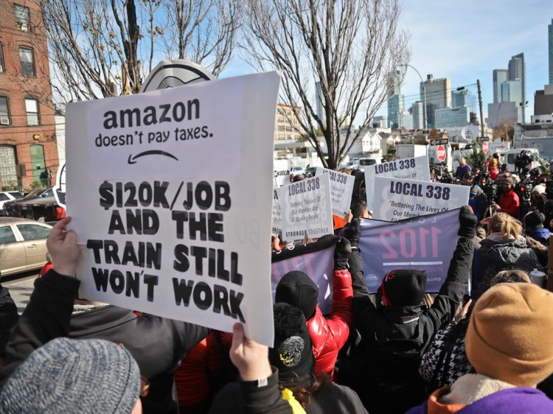

Motivation
State and local governments use incentives to attract and retain businesses
Many factors influence company’s decision to locate
Do incentives programs net out positively in the long run or do they give away the farm?
Politicians may only offer economic incentives to enhance reelection
Notes:
- Economic incentives include (at least in the case of my paper): Investment tax credits (ITC), Job Creation Tax Credit (JCTC), Research and Development tax credits (RDC), property tax abatement (PTA), and Custom Job Training Subsidies (CJTS)
If the incentive is not affecting the decision of the company, then instead it is just transferring wealth from taxpayers to high-income owners of large businesses
Scott Walker is the refutation of the electoral prospects thesis

Slide 4
Question
Do incentives offered by state and local governments to attract businesses actually result in increased business activity and positive GDP growth?

Slide 5
Background & Literature Review
They Work
They Sometimes Work
They Never Work
Companies do locate because of incentives
Benefits in jobs, wages, and economic growth more than offset short-term loss in tax revenue
Bureaucrats can be dumb
Mismatch between state and city goals
Front-loading tax breaks is more effective
Clawbacks and performance requirements
Incentives are not a factor in location decisions
Economic benefits do not outweigh upfront costs
Incentives crowd out investment and create bad capital allocation
Notes:
They Work
Do affect location decisions: (Bartik 2005, Rubin 1991, Chapman and Walker 1990, Walker and Greeenstreet 1989, Schmenner 1982)
Peters and Fisher (2004) find that offering a job creation tax credit equal to $2,800 per job for a branch plant would result in an increase of 30% in the probability of a firm choosing the offering location over a similar location not offering the incentive
More than offset revenue loss (Arguments): (Peters and Fisher 2004, Bartik 2003, Bartik 1991).
More than offset revenue loss (Empirical): (O’Connor 2011, Busso and Kline 2008, Bartik 2005, Wu 2005, Peters and Fisher 2004, Wasylenko and McGuire 1985, Newman 1983)
They Sometimes Work
Bureaucrats can be dumb: Some have pointed to human capital flaws in local economic development authorities that doom complex incentives structures from the start (Dewar 1998).
Mismatch of goals: Others sympathize with heads of economic development authorities as they are bound by the often competing incentives of higher-level government authorities with electoral interests
Frontloading: Bartik (2017) argues that shorter-term incentives that front-load tax breaks and subsidies have a higher likelihood of influencing relocation decisions and affecting long-term economic development prospects due to the way corporate accounting processes function
They Never Work
Not a factor in decisions: More survey based methodology - factors related to ease of living, human capital support, or corporate strategy matter more (Peters and Fisher 2004, Weber 2000, Rondinelli and Burpitt 2000, O’Mara 1999, Lynch 1995)
Economic incentives do not outweigh upfront costs (Argument): (Blomström 2002, Rodríguez‐Pose and Arbix 2001).
Do not outweigh costs (empirical): (De Blasio, Fantino, and Pellegrini 2014, Peters 2002, Rodriguez-Pose and Arbiz 2001, Boarnet and Bogart 1996, Schweke, Rist, and Dabson 1994, Carlton 1983)
Crowd out: While they do increase R&D spending within the state in the short-term, they also draw it away from other localities in the long-term, resulting in no net gain overall (Wilson 2009) (Wilson 2009, Gorin 2008, Peters and Fisher 2004, Fisher and Peters 1997)
Methodology Problems
Survey methodology
Case studies
Mismatch of unit analysis – Impact of city incentives on state gdp growth
No control group and just looked over time
Too short of a timeline of analysis

Slide 6
Conceptual Framework
Large company with jobs and economic growth prospects relocating
Investment Tax Credit (ITC)
Job Creation Tax Credit (JCTC)
Research and Development Tax Credit (RDC)
Property Tax Abatement (PTA)
Custom Job Training Subsidy (CJTS)
Nudge a Company to Choose the Location
Increased Jobs, Tax Revenue, and Wage Increases
Better public services and amenities

Slide 7
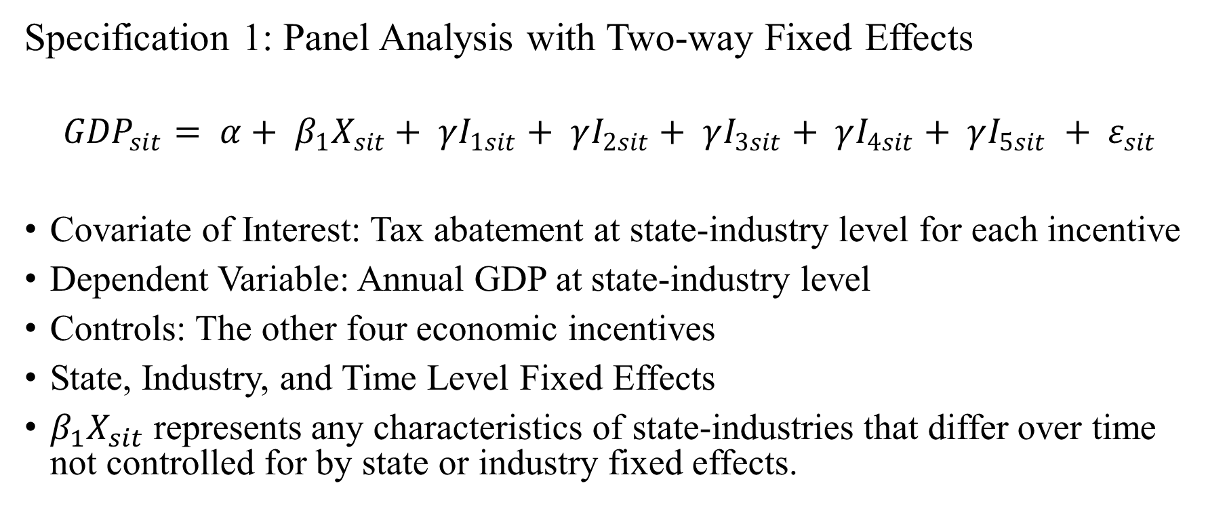
Empirical Framework
Specification 1: Panel Analysis with Two-way Fixed Effects
$${GDP}_{sit}= α+ β_{1}X_{sit}+ γI_{1sit}+ γI_{2sit}+ γI_{3sit}+ γI_{4sit}+ γI_{5sit} + ε_{sit}$$
Covariate of Interest: Tax abatement at state-industry level for each incentive
Dependent Variable: Annual GDP at state-industry level
Controls: The other four economic incentives
State, Industry, and Time Level Fixed Effects
$β_{1}X_{sit}$ represents any characteristics of state-industries that differ over time not controlled for by state or industry fixed effects.
Notes:
First, state-industry-level fixed effects will be included to capture differences across combinations of the 33 states and 45 industries included in the sample. Second, year-level fixed effects will be included to account for potential shocks in a given year (the years covering the financial crisis are included in the dataset, for example).
Demographics change over time differently for states, so this would be something to control for in the observed, and same for the visaversa with time

Slide 8
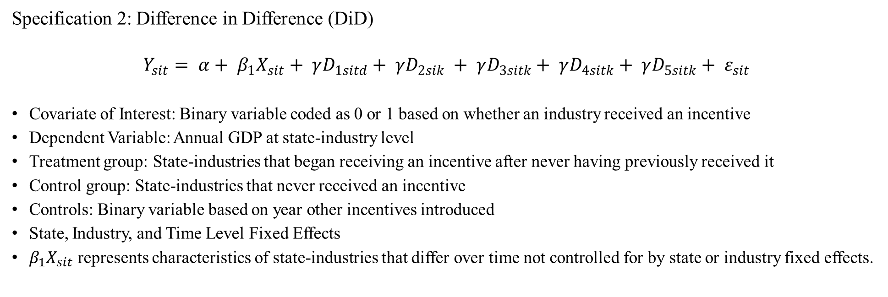
Empirical Framework
Specification 2: Difference in Difference (DiD)
$$Y_{sit}= α+ β_{1}X_{sit}+ γD_{1sitd}+ γD_{2sik} + γD_{3sitk}+ γD_{4sitk}+ γD_{5sitk}+ ε_{sit}$$
Covariate of Interest: Binary variable coded as 0 or 1 based on whether an industry received an incentive
Dependent Variable: Annual GDP at state-industry level
Treatment group: State-industries that began receiving an incentive after never having previously received it
Control group: State-industries that never received an incentive
Controls: Binary variable based on year other incentives introduced
State, Industry, and Time Level Fixed Effects
$β_{1}X_{sit}$ represents characteristics of state-industries that differ over time not controlled for by state or industry fixed effects.
Incentive | DiD_Year | Treatment_Industries | Treatment_States | Control_Industries | Control_States
JCTC | 2004 | 52 | 2 | 390 | 30
ITC | 1998 | 59 | 2 | 583 | 31
RDC | 2000 | 99 | 10 | 321 | 24
PTA | 2000 | 33 | 1 | 651 | 28
CJTS | 2001 | 59 | 2 | 375 | 27
Notes:
Explain DiD
The results of the evaluation therefore will hinge upon whether or not state-industries that began receiving incentives in a particular year experienced any significant divergence in GDP growth rates compared to those state-industries not receiving the incentive.
The DiD approach will also maintain the state, industry, and year level fixed effects included in the first identification strategy as DiD is simply a special case of applied longitudinal analysis that focuses on changes in a dependent variable from T =1 to T = 2.
Cov of Interest: 0 or 1 based on receiving the incentive in a given year
This process will be done separately for each incentive type, and therefore the year used as the DiD estimation year may be different across the five incentive types.
For the DiD analysis that looks at the effect of introducing an effect, we talked about needing to control for 1) other incentives existing before the introduction of this effect (can control for via fixed effects), 2) other incentives being introduced at the same year as the one I'm interested in (would have to talk about combined effect, and 3) other incentives introduced after the DiD cutoff but within the assessment period (would need to add dummy equal to 1 for the time period in which the second incentive occurred.
The d subscript on the $D_{1}$ explanatory term denotes the year upon which the incentive in question was adopted and the subsequent $γD_{sik}$ terms represent the years after the incentive in question is adopted in which state-industries begin receiving each of the other four incentives, if at all.
Also add State GDP
We add another layer of analysis by using state-level GDP, as opposed to state-industry GDP, for a given year as the dependent variable in both specifications described above. This way, we can evaluate whether any improvement in one state-industry might be coming at the cost of the broader state economy.

Slide 9

Data
W.E. Upjohn Institute for Employment Research Panel Database on Incentives and Taxes
45 industries in 47 cities in 33 states collected from 1990 to 2015
Dataset is not a repository of actual incentives but is a “tax and incentive simulation”
Notes:
33 states compose 92 percent of US GDP and the 45 industries compose 91 percent of US labor compensation
like that maintained by Incentives Monitor
Instead, the database is derived from carrying out a “tax and incentive simulation” whereby a business in some industry i creates a new branch facility to be set up in city c in state s that will start operation in year t
Overall, what amounts to 65 percent of total state and local business taxes is covered in the dataset, with that number being higher for industries that are not subject to taxes left out of the database such as public utility taxes and insurance premium taxes
C2ER: Council for Community and Economic Research (C2ER)
The “output, value-added, real and personal property, labor, and purchases of intermediate inputs” the branch facility would bring comes from a constructed balance sheet derived from BEA Industry accounts data, IRS data on Statistics and Income, and National Science Foundation data on R&D spending

Slide 10
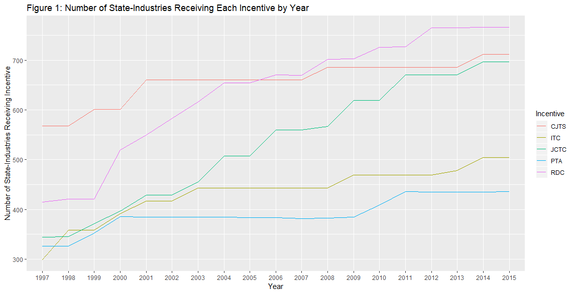
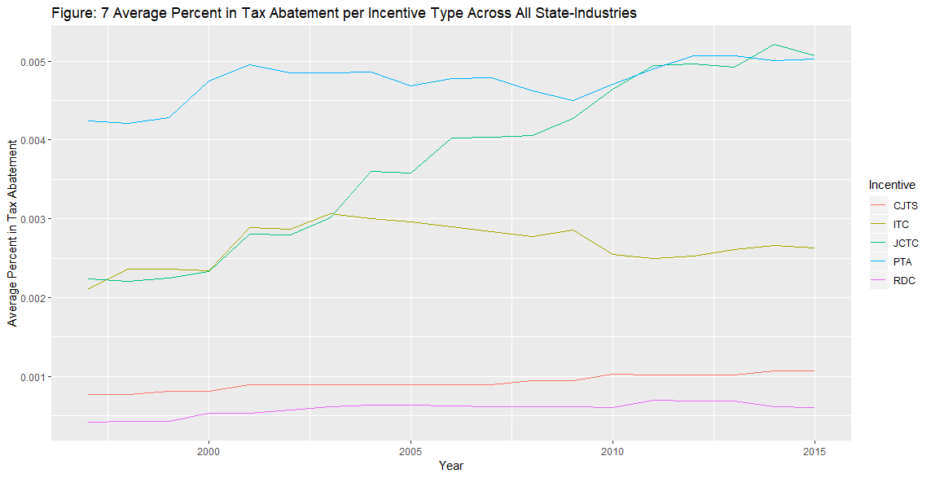
Data
Information in incentives rates come primarily from:
C2ER
Good Jobs First
Local laws and policies
Websites of city and state EDAs
Information on state and local taxes comes from:
Lincoln Institute of Land Policy
Minnesota Center for Fiscal Excellence
Gross tax receipts from Commerce Clearing House State Tax Guides
Notes:
C2ER: Council for Community and Economic Research (C2ER)
The “output, value-added, real and personal property, labor, and purchases of intermediate inputs” the branch facility would bring comes from a constructed balance sheet derived from BEA Industry accounts data, IRS data on Statistics and Income, and National Science Foundation data on R&D spending
Property tax abatements tend to be utilized the least, which makes sense given that property taxes often serve as the primary source of revenue generation for municipalities across the country.

Slide 11
Data - Update
Panel Database is merged with state-industry GDP data from BEA
GDP data collected by BEA is comprised of:
Labor income
Business taxes
Capital Income
1990-1996 data dropped due to SIC to NAICS code switch in 1997
Final dataset contains 20,657 observations.
Notes:
The GDP data collected by BEA is comprised of three components: labor income (wages, salaries, and other benefits), business taxes (excise, sales, property, and other business expense taxes), and capital income (income earned by individual or business and deprivation)
Each data point is collected through a rigorous methodology that includes estimation using BEA’s state personal income (SPI)and industry accounts, business payment and financial data from the Census Bureau, and value-added data from the Department of Agriculture.
While tools to crosswalk SIC and NAICS codes do exist, it is impossible to match the definitions without over or under counting the GDP levels of specific industry groupings and BEA even cautions scholars against trying to append the datasets together to develop a consistent timeline for 1963 to 2016

Slide 12
State-Industry GDP Dependent Variable
Full Sample: No Government Financing Variables Included

Slide 13
 | (1) | (2) | (3) | (4) | (5) | (6) | (7) | (8) | (9) | (10) | (11)
VARIABLES | Base Model - Index | Base Model - Each Incentive | FE - Index | FE - Each Incentive | PSM-Backed FE - Index - Strata 1 | PSM-Backed FE - Index - Strata 2 | PSM-Backed FE - Index - Strata 3 | PSM-Backed FE - Index – Strata 4 | PSM-Backed FE - Index – Strata 5 | Exposure Model - Index | Exposure Model - Each Incentive
jctc |  | -20,604 |  | -91,586**
 |  | (13,382) |  | (36,901)
itc |  | -45,777*** |  | -91,886
 |  | (12,211) |  | (150,527)
rdc |  | 428,268*** |  | 426,663**
 |  | (61,531) |  | (197,557)
pta |  | 103,740*** |  | 120,004**
 |  | (6,952) |  | (45,513)
cjts |  | -59,505** |  | -5,096
 |  | (24,573) |  | (217,261)
matchindex | 3.311e+06*** |  | 3.451e+06*** |  | 1.412e+06** | 2.268e+06*** | 3.390e+06*** | 3.994e+06*** | 5.839e+06***
 | (147,944) |  | (816,610) |  | (536,477) | (513,387) | (675,767) | (781,129) | (1.540e+06)
IncentivesTab |  |  |  |  | -294.8 | -1,367 | 787.0 | 3,648* | 5,057**
 |  |  |  |  | (599.5) | (1,567) | (1,814) | (1,955) | (2,098)
avgindex |  |  |  |  |  |  |  |  |  | 4.845e+06***
 |  |  |  |  |  |  |  |  |  | (1.337e+06)
avgjctc |  |  |  |  |  |  |  |  |  |  | -122,823**
 |  |  |  |  |  |  |  |  |  |  | (50,618)
avgitc |  |  |  |  |  |  |  |  |  |  | -102,599
 |  |  |  |  |  |  |  |  |  |  | (137,121)
avgrdc |  |  |  |  |  |  |  |  |  |  | 770,467*
 |  |  |  |  |  |  |  |  |  |  | (378,553)
avgpta |  |  |  |  |  |  |  |  |  |  | 171,006**
 |  |  |  |  |  |  |  |  |  |  | (68,994)
avgcjts |  |  |  |  |  |  |  |  |  |  | -42,671
 |  |  |  |  |  |  |  |  |  |  | (214,259)
Observations | 19,568 | 19,568 | 19,568 | 19,568 | 3,927 | 3,927 | 3,894 | 3,927 | 3,893 | 1,087 | 1,087
R-squared | 0.486 | 0.381 | 0.326 | 0.185 | 0.305 | 0.366 | 0.410 | 0.365 | 0.389 | 0.496 | 0.397
Robust Standard Errors | YES | YES | YES | YES | YES | YES | YES | YES | YES | YES | YES
Long-Term Effects |  |  |  |  |  |  |  |  |  | YES | YES
Number of State_num_id |  |  | 33 | 33 | 21 | 28 | 28 | 26 | 20
State-Industry FE |  |  | YES | YES | YES | YES | YES | YES | YES
Year FE |  |  | YES | YES | YES | YES | YES | YES | YES
Notes:
Smallest SEs on exposure model, but still big

Slide 14
State GDP Dependent Variable
Full Sample: No Government Financing Variables Included

Slide 15
 | (1) | (2) | (3) | (4) | (5) | (6) | (7) | (8) | (9) | (10) | (11)
VARIABLES | Base Model - Index | Base Model - Each Incentive | FE - Index | FE - Each Incentive | PSM-Backed FE - Index - Strata 1 | PSM-Backed FE - Index - Strata 2 | PSM-Backed FE - Index - Strata 3 | PSM-Backed FE - Index - Strata 4 | PSM-Backed FE - Index - Strata 5 | Exposure Model - Index | Exposure Model - Each Incentive
jctc |  | 1.859e+06*** |  | 520,490
 |  | (79,433) |  | (401,609)
itc |  | -31,173 |  | -175,081
 |  | (78,891) |  | (171,684)
rdc |  | 111,805 |  | 175,760
 |  | (235,111) |  | (163,266)
pta |  | 772,391*** |  | -118,224
 |  | (39,952) |  | (121,314)
cjts |  | -2.676e+06*** |  | -303,462
 |  | (153,032) |  | (329,651)
matchindex | 2.797e+06*** |  | 347,787* |  | 57,293 | 48,681 | 169,365* | 160,717* | 618.3
 | (355,567) |  | (201,694) |  | (43,511) | (29,793) | (88,515) | (89,429) | (143,413)
IncentivesTab |  |  |  |  | 935.6 | -416.5* | 687.7** | 525.2 | -632.5
 |  |  |  |  | (991.9) | (230.4) | (320.1) | (471.2) | (543.4)
avgindex |  |  |  |  |  |  |  |  |  | -1.078e+06
 |  |  |  |  |  |  |  |  |  | (1.598e+06)
avgjctc |  |  |  |  |  |  |  |  |  |  | 771,800
 |  |  |  |  |  |  |  |  |  |  | (915,271)
avgitc |  |  |  |  |  |  |  |  |  |  | 478,821
 |  |  |  |  |  |  |  |  |  |  | (791,676)
avgrdc |  |  |  |  |  |  |  |  |  |  | 3.284e+06*
 |  |  |  |  |  |  |  |  |  |  | (1.661e+06)
avgpta |  |  |  |  |  |  |  |  |  |  | -1.065e+06
 |  |  |  |  |  |  |  |  |  |  | (692,216)
avgcjts |  |  |  |  |  |  |  |  |  |  | 683,723
 |  |  |  |  |  |  |  |  |  |  | (3.204e+06)
Observations | 19,568 | 19,568 | 19,568 | 19,568 | 3,927 | 3,927 | 3,894 | 3,927 | 3,893 | 1,087 | 1,087
R-squared | 0.984 | 0.985 | 0.956 | 0.957 | 0.987 | 0.992 | 0.992 | 0.995 | 0.990 | 0.993 | 0.994
Robust Standard Errors | YES | YES | YES | YES | YES | YES | YES | YES | YES | YES | YES
Long-Term Effects |  |  |  |  |  |  |  |  |  | YES | YES
Number of State_num_id |  |  | 33 | 33 | 21 | 28 | 28 | 26 | 20
State-Industry FE |  |  | YES | YES | YES | YES | YES | YES | YES
Year FE |  |  | YES | YES | YES | YES | YES | YES | YES

Slide 16
Industry Value Added GDP Dependent Variable
Full Sample: No Government Financing Variables Included

Slide 17
 | (1) | (2) | (3) | (4) | (5) | (6) | (7) | (8) | (9) | (10) | (11)
VARIABLES | Base Model - Index | Base Model - Each Incentive | FE - Index | FE - Each Incentive | PSM-Backed FE - Index - Strata 1 | PSM-Backed FE - Index - Strata 2 | PSM-Backed FE - Index - Strata 3 | PSM-Backed FE - Index – Strata 4 | PSM-Backed FE - Index – Strata 5 | Exposure Model - Index | Exposure Model - Each Incentive
jctc |  | -2.821e+08* |  | -1.761e+09***
 |  | (1.565e+08) |  | (5.940e+08)
itc |  | -3.922e+08** |  | 4.774e+08
 |  | (1.787e+08) |  | (7.742e+08)
rdc |  | 4.025e+09*** |  | 6.122e+08
 |  | (4.984e+08) |  | (9.417e+08)
pta |  | 2.069e+09*** |  | 2.123e+09***
 |  | (1.412e+08) |  | (3.607e+08)
cjts |  | -3.180e+09*** |  | -1.480e+10***
 |  | (5.826e+08) |  | (2.728e+09)
matchindex | 3.197e+10*** |  | 3.198e+10*** |  | 3.044e+10*** | 4.166e+10*** | 3.463e+10*** | 3.060e+10*** | 2.641e+10***
 | (1.457e+09) |  | (4.290e+09) |  | (5.897e+09) | (5.861e+09) | (6.310e+09) | (6.271e+09) | (6.511e+09)
IncentivesTab |  |  |  |  | -1.355e+07 | -8.146e+06 | 2.897e+07 | 1.465e+07 | 9.018e+07**
 |  |  |  |  | (8.248e+06) | (1.568e+07) | (1.767e+07) | (1.765e+07) | (3.572e+07)
avgindex |  |  |  |  |  |  |  |  |  | 3.719e+10***
 |  |  |  |  |  |  |  |  |  | (4.329e+09)
avgjctc |  |  |  |  |  |  |  |  |  |  | -1.175e+09
 |  |  |  |  |  |  |  |  |  |  | (7.138e+08)
avgitc |  |  |  |  |  |  |  |  |  |  | -8.982e+08
 |  |  |  |  |  |  |  |  |  |  | (8.224e+08)
avgrdc |  |  |  |  |  |  |  |  |  |  | 5.126e+09***
 |  |  |  |  |  |  |  |  |  |  | (1.692e+09)
avgpta |  |  |  |  |  |  |  |  |  |  | 3.137e+09***
 |  |  |  |  |  |  |  |  |  |  | (5.378e+08)
avgcjts |  |  |  |  |  |  |  |  |  |  | -9.329e+09***
 |  |  |  |  |  |  |  |  |  |  | (2.666e+09)
Constant |  |  |  |  | 9.788e+08*** | 7.783e+08*** | 2.334e+08 | 8.330e+08*** | 4.367e+08*
 |  |  |  |  | (1.696e+08) | (1.467e+08) | (1.726e+08) | (2.428e+08) | (2.254e+08)
Observations | 19,568 | 19,568 | 19,568 | 19,568 | 3,927 | 3,927 | 3,894 | 3,927 | 3,893 | 1,087 | 1,087
R-squared | 0.458 | 0.435 | 0.495 | 0.480 | 0.513 | 0.519 | 0.497 | 0.503 | 0.501 | 0.479 | 0.459
Robust Standard Errors | YES | YES | YES | YES | YES | YES | YES | YES | YES | YES | YES
Long-Term Effects |  |  |  |  |  |  |  |  |  | YES | YES
Number of State_num_id |  |  | 33 | 33 | 21 | 28 | 28 | 26 | 20
State-Industry FE |  |  | YES | YES | YES | YES | YES | YES | YES
Year FE |  |  | YES | YES | YES | YES | YES | YES | YES

Slide 18
State-Industry GDP Dependent Variable with Government Financing Controls
Reduced Sample: State financing variables knock out DC

Slide 19
 | (1) | (2) | (3) | (4) | (5) | (6) | (7) | (8) | (9) | (10) | (11)
VARIABLES | Base Model - Index | Base Model - Each Incentive | FE - Index | FE - Each Incentive | PSM-Backed FE - Index - Strata 1 | PSM-Backed FE - Index – Strata 2 | PSM-Backed FE - Index - Strata 3 | PSM-Backed FE - Index - Strata 4 | PSM-Backed FE - Index - Strata 5 | Exposure Model - Index | Exposure Model - Each Incentive
jctc |  | -42,093*** |  | -166,042***
 |  | (12,220) |  | (45,355)
itc |  | -64,456*** |  | -200,327
 |  | (12,751) |  | (158,046)
rdc |  | 440,375*** |  | -430,212**
 |  | (61,824) |  | (170,490)
pta |  | 101,738*** |  | 37,668
 |  | (7,641) |  | (48,860)
cjts |  | -36,037 |  | -265,176
 |  | (24,577) |  | (380,348)
matchindex | 3.356e+06*** |  | 3.493e+06*** |  | -236,704 | 1.538e+06** | 841,986* | 1.691e+06 | 3.561e+06
 | (150,318) |  | (831,137) |  | (673,026) | (634,923) | (476,884) | (1.361e+06) | (2.675e+06)
IncentivesTab |  |  |  |  | -198.8 | -1,250 | -2,468** | -1,199 | -1,798
 |  |  |  |  | (962.2) | (1,147) | (1,204) | (2,717) | (5,012)
avgindex |  |  |  |  |  |  |  |  |  | 4.932e+06***
 |  |  |  |  |  |  |  |  |  | (1.367e+06)
avgjctc |  |  |  |  |  |  |  |  |  |  | -125,157**
 |  |  |  |  |  |  |  |  |  |  | (50,606)
avgitc |  |  |  |  |  |  |  |  |  |  | -101,508
 |  |  |  |  |  |  |  |  |  |  | (142,935)
avgrdc |  |  |  |  |  |  |  |  |  |  | 789,377**
 |  |  |  |  |  |  |  |  |  |  | (379,449)
avgpta |  |  |  |  |  |  |  |  |  |  | 200,555**
 |  |  |  |  |  |  |  |  |  |  | (79,155)
avgcjts |  |  |  |  |  |  |  |  |  |  | -103,936
 |  |  |  |  |  |  |  |  |  |  | (252,250)
Observations | 19,008 | 19,008 | 19,008 | 19,008 | 807 | 806 | 807 | 806 | 806 | 1,056 | 1,056
R-squared | 0.489 | 0.383 | 0.331 | 0.345 | 0.351 | 0.476 | 0.389 | 0.387 | 0.429 | 0.498 | 0.398
Robust Standard Errors | YES | YES | YES | YES | YES | YES | YES | YES | YES | YES | YES
Long-Term Effects |  |  |  |  |  |  |  |  |  | YES | YES
Number of State_num_id |  |  | 32 | 32 | 29 | 31 | 32 | 28 | 20
State-Industry FE |  |  | YES | YES | YES | YES | YES | YES | YES
Year FE |  |  | YES | YES | YES | YES | YES | YES | YES

Slide 20
State GDP Dependent Variable with Government Financing Controls
Reduced Sample: State financing variables knock out DC

Slide 21
 | (1) | (2) | (3) | (4) | (5) | (6) | (7) | (8) | (9) | (10) | (11)
VARIABLES | Base Model - Index | Base Model - Each Incentive | FE - Index | FE - Each Incentive | PSM-Backed FE - Index - Strata 1 | PSM-Backed FE - Index – Strata 2 | PSM-Backed FE - Index - Strata 3 | PSM-Backed FE - Index – Strata 4 | PSM-Backed FE - Index - Strata 5 | Exposure Model - Index | Exposure Model - Each Incentive
jctc |  | 1.187e+06*** |  | 87,222
 |  | (49,367) |  | (158,741)
itc |  | -682,445*** |  | -133,289
 |  | (45,874) |  | (125,918)
rdc |  | 395,075** |  | 61,056
 |  | (177,519) |  | (133,100)
pta |  | 82,349*** |  | -133,551
 |  | (31,348) |  | (90,198)
cjts |  | -704,521*** |  | 276,289
 |  | (115,120) |  | (291,182)
matchindex | 636,021*** |  | 93,805 |  | -1.030e+06 | 390,944 | -125,854 | 501,491 | -1.955e+06*
 | (199,036) |  | (97,310) |  | (3.000e+06) | (575,260) | (323,114) | (517,050) | (969,515)
IncentivesTab |  |  |  |  | 4,371 | -4,023** | -3,111* | 3,356 | -2,013
 |  |  |  |  | (4,509) | (1,956) | (1,537) | (5,671) | (1,714)
avgindex |  |  |  |  |  |  |  |  |  | 174,515
 |  |  |  |  |  |  |  |  |  | (890,562)
avgjctc |  |  |  |  |  |  |  |  |  |  | 515,012
 |  |  |  |  |  |  |  |  |  |  | (572,474)
avgitc |  |  |  |  |  |  |  |  |  |  | 855,146
 |  |  |  |  |  |  |  |  |  |  | (522,191)
avgrdc |  |  |  |  |  |  |  |  |  |  | 1.321e+06
 |  |  |  |  |  |  |  |  |  |  | (1.006e+06)
avgpta |  |  |  |  |  |  |  |  |  |  | 135,745
 |  |  |  |  |  |  |  |  |  |  | (296,809)
avgcjts |  |  |  |  |  |  |  |  |  |  | -1.740e+06
 |  |  |  |  |  |  |  |  |  |  | (1.253e+06)
Observations | 19,008 | 19,008 | 19,008 | 19,008 | 807 | 806 | 807 | 806 | 806 | 1,056 | 1,056
R-squared | 0.991 | 0.991 | 0.972 | 0.972 | 0.986 | 0.973 | 0.992 | 0.989 | 0.992 | 0.998 | 0.998
Robust Standard Errors | YES | YES | YES | YES | YES | YES | YES | YES | YES | YES | YES
Long-Term Effects |  |  |  |  |  |  |  |  |  | YES | YES
Number of State_num_id |  |  | 32 | 32 | 29 | 31 | 32 | 28 | 20
State-Industry FE |  |  | YES | YES | YES | YES | YES | YES | YES
Year FE |  |  | YES | YES | YES | YES | YES | YES | YES

Slide 22
Industry Added Value Dependent Variable with Government Financing Controls
Reduced Sample: State financing variables knock out DC

Slide 23
 | (1) | (2) | (3) | (4) | (5) | (6) | (7) | (8) | (9) | (10) | (11)
VARIABLES | Base Model - Index | Base Model - Each Incentive | FE - Index | FE - Each Incentive | PSM-Backed FE - Index - Strata 1 | PSM-Backed FE - Index – Strata 2 | PSM-Backed FE - Index – Strata 3 | PSM-Backed FE - Index - Strata 4 | PSM-Backed FE - Index - Strata 5 | Exposure Model - Index | Exposure Model - Each Incentive
jctc |  | -2.104e+08 |  | -2.300e+09***
 |  | (1.657e+08) |  | (6.500e+08)
itc |  | -3.519e+08* |  | -6.529e+08
 |  | (1.874e+08) |  | (6.942e+08)
rdc |  | 4.226e+09*** |  | -7.535e+09***
 |  | (5.008e+08) |  | (1.739e+09)
pta |  | 2.157e+09*** |  | 1.465e+09***
 |  | (1.469e+08) |  | (4.458e+08)
cjts |  | -2.922e+09*** |  | -1.765e+10***
 |  | (5.973e+08) |  | (3.957e+09)
matchindex | 3.256e+10*** |  | 3.190e+10*** |  | -3.378e+10 | 5.600e+10*** | 6.766e+10*** | 1.012e+11** | 1.337e+11**
 | (1.491e+09) |  | (4.284e+09) |  | (3.127e+10) | (1.229e+10) | (2.188e+10) | (4.337e+10) | (4.933e+10)
IncentivesTab |  |  |  |  | -8.716e+07*** | -1.223e+08*** | -1.356e+08*** | -1.668e+08*** | -1.849e+08***
 |  |  |  |  | (2.459e+07) | (3.030e+07) | (4.655e+07) | (3.033e+07) | (4.072e+07)
avgindex |  |  |  |  |  |  |  |  |  | 3.739e+10***
 |  |  |  |  |  |  |  |  |  | (4.473e+09)
avgjctc |  |  |  |  |  |  |  |  |  |  | -1.196e+09
 |  |  |  |  |  |  |  |  |  |  | (7.245e+08)
avgitc |  |  |  |  |  |  |  |  |  |  | -1.013e+09
 |  |  |  |  |  |  |  |  |  |  | (8.417e+08)
avgrdc |  |  |  |  |  |  |  |  |  |  | 5.527e+09***
 |  |  |  |  |  |  |  |  |  |  | (1.826e+09)
avgpta |  |  |  |  |  |  |  |  |  |  | 3.402e+09***
 |  |  |  |  |  |  |  |  |  |  | (5.287e+08)
avgcjts |  |  |  |  |  |  |  |  |  |  | -9.577e+09***
 |  |  |  |  |  |  |  |  |  |  | (2.437e+09)
Observations | 19,008 | 19,008 | 19,008 | 19,008 | 807 | 806 | 807 | 806 | 806 | 1,056 | 1,056
R-squared | 0.460 | 0.436 | 0.496 | 0.513 | 0.650 | 0.658 | 0.622 | 0.658 | 0.705 | 0.482 | 0.461
Robust Standard Errors | YES | YES | YES | YES | YES | YES | YES | YES | YES | YES | YES
Long-Term Effects |  |  |  |  |  |  |  |  |  | YES | YES
Number of State_num_id |  |  | 32 | 32 | 29 | 31 | 32 | 28 | 20
State-Industry FE |  |  | YES | YES | YES | YES | YES | YES | YES
Year FE |  |  | YES | YES | YES | YES | YES | YES | YES

Slide 24
Considerations and Limitations
Considerations
Limitations
Two separate unit-level fixed effects (state and industry) or one (state-industry)
Triple Diff: Interacting fixed effects or controlling for observables
Removal of incentives in treatment groups
Potential confounding effects
May be too many ad hoc parts of incentive programs
Financial crisis effect
How long does it take for economic incentives to make a difference?
Can’t get at “They Sometimes Work” outside of fixed effects
Notes:
– the size and type of incentives can influence GDP growth but GDP growth can also affect the size and type of incentives
Too many ad hoc on deal by deal meaning that the modeling is not good enough
It is challenging, but ultimately might be easy to control for in regards to financial crisis
For example, with Amazon, we’re structuring all the performance requirements and such on a ten year timeline
Might be able to limit assessment timeline to before the incentives are dropped, but then we run into the how long does it take economic incentives issue

